Slide 1
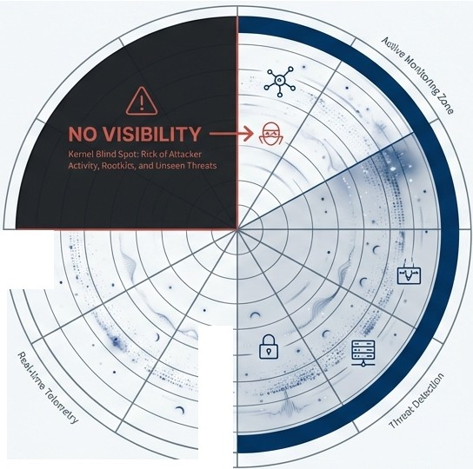
Your EDR Has a Blind Spot.
Enhancing Endpoint Security with Linux Kernel Runtime Protection.
•
..:...:••
RLC-H

Slide 2






You've Secured the Userspace. But What Lies Beneath?
Modern Endpoint Detection & Response (EDR) solutions provide excellent visibility into userspace
activities-manitoring
processes, file access, and network connections connections. This is a critical layer of defense.
Userspace
Processes
Applications
EDR AGENT
Kernel
Scheduler
Memory Mgmt
System Calls

Slide 3



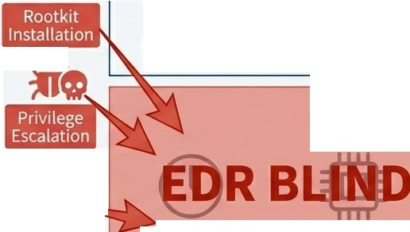

The Kernel: The Ultimate Target, The Ultimate Blind Spot.
Adversaries target the kernel to gain ultimate control and
Userspace
lie,
persistence. By operating -� at this level, their
their activities occur
below the visibility plane of traditional EDR agents, rendering them invisible.
Processes
Applications
EDR AGENT
lie•
Kernel
�v,_�
.........._
Credential
Scheduler
Memory Mgmt
System Calls
Manipulation

Slide 4



LKRG: Your Eyes Inside the Kernel
Linux Kernel Runtime Guard (LKRG} is a kernel module designed to provide real-timeintegrity monitoring and exploit detection where you need it most.
Kernel Integrity Monitoring
Detects unauthorized modifications to kernel code and critical data structures, catching rootkit installations in real-time.
Exploit Detection
Identifies privilege escalation attempts, including UID/GID manipulation and process credential swapping attacks.
Runtime Protection
Validates operations *before* the kernel grants access, stopping certain exploits before they can cause damage.

Slide 5

Complementary, Not Competitive.
LKRGIS
A kernel-level integrity monitor.
A runtime exploit detector.
A source for unique kernel telemetry.
A complementary security layer to traditional EDR.
X A userspace behavioral analysis tool.
X A file-based malware scanner.
X A network traffic analyzer.
X A complete Incident Response (IR} platform.
LKRG enhances your existing EDR investment by adding a critical layer of kernel-level detection.

Slide 6
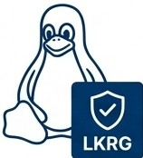






Turning Kernel Events into Actionable Intelligence
LKRG integrates into your existing security ecosystem by leveraging standard Linux logging infrastructure. There's no proprietary agent or complex log transport to deploy.
The log format is a standard kernel message with a [p_lkrg] or [ LKRG] prefix for easy parsing and filtering.
• ••
@N =- nI1Il
Linux Kernel
Kernel Log Buffer (dmesg)
Syslog Daemon (rsyslog)
SIEM Platform
(e.g., Splunk, Elastic)

Slide 7
Deploying LKRG as a Pure Kernel Sensor
For seamless integration into a security monitoring setup, LKRG can be run in a log-only "sensor mode." In this profile, all detections are logged for analysis in your SIEM, but no enforcement actions are taken on the host.
# To enable sensor-only mode:
# Set the following kernel parameter at boot or via sysctl: lkrg.profile_enforce=0
As the source documentation states, this is ''useful where LKRG is meant to act as a sensor within a larger security monitoring and response setup (e.g., network-wide)."

Slide 8



The Power of Correlation: A Unified View of an Attack.
Endpoint
SIEM
TRIGGER: CRITICAL INCIDENT
CONDITION:
IF an LKRG event detects 'process credential manipulation' on Host A AND an EDR event detects 'lateral movement' originating from Host A within 5 minutes
--9�
�)�
Traditional EDRAgent
iJ,o
0
Correlation Engine
Thistransformstwo separate, lower-priority alerts into a single, high-confidencesignal of an active compromise.
LKRG
(Kernel Sensor)

Slide 9
The RLC-H Advantage: Integrated Kernel Protection.
While LKRG can be compiled and installed on many systems, RLC-H is the only hardened enterprise Linux distribution that delivers this critical capability pre-integrated,validated, and commercially supported.
Feature | Standard Enterprise Linux (RHEL, SUSE)
 |  | Traditional EDR (CrowdStrike, etc.) |  | RLC-H
Userspace Visibility | X Limited | Yes |  | ​Yes (via EDR)
Kernel Runtime Integrity | X No | X No (Blind Spot) |  | Yes (LKRG Pre-Integrated)

Slide 10




See Deeper. Detect Earlier. Respond Smarter.
THE GAP
Traditional EDR is blind to kernel-level attacks like rootkits and sophisticated privilege escalation.
THE SENSOR
LKRG provides unique, real-time telemetry on kernel integrity and exploit attempts, filling this critical visibility gap.
THE INTEGRATION
LKRG telemetry integrates with your existing SIEM today via standard syslog forwarding, enriching your EDR data.
THE PLATFORM
RLC-H delivers this capability as a pre-integrated, hardened, and commercially supported solution.
--
,,,,..,,
The value proposition is filling the EDR visibility gap at the kernel level,
not replacing your existing security investments.

